Slide 1
WELCOME

Slide 2
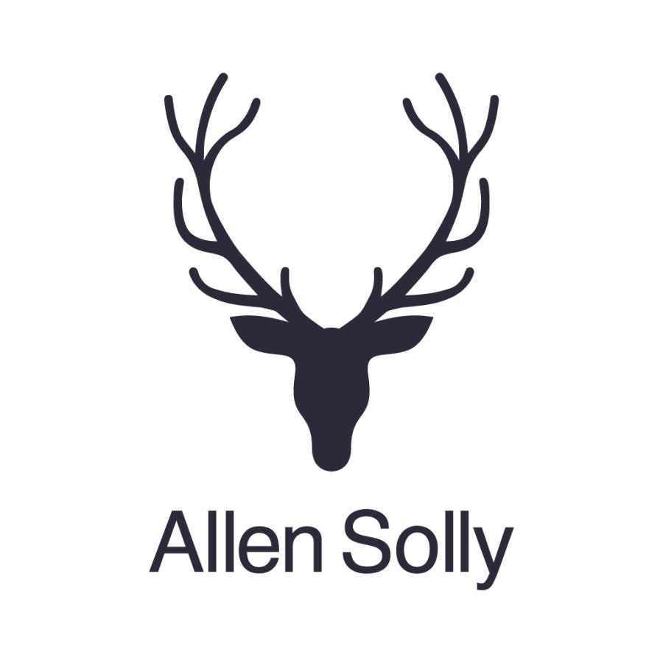
ALLEN SOLLY
DIGITAL MARKETING FOR

Slide 3
VARSHA GURUGUBELLI (TEAM LEADER)
DUMMU RAJU (Team member)
DALLI SRAVANI (Team member)
GINNI NAVYA (Team member)
DOLAI VIJAY LAKSHMI (Team member)
Team details

Slide 4
PART-1
Brand Study
Competitor Analysis
Buyer’s/Audience’s Persona

Slide 5
Brand study:
The logo is in honour of the brand's heritage and its roots.
Allen Solly is a brand that transformed the dressing lifestyles of Indian officials.
Allen Solly brand has progressed swiftly in the past years becoming one of the fastest growing brands in India.
Allen Solly (www.allensolly.com) is a fashion brand and a business that can be found in online . Allen Solly is known for its classy look.
Values:
The brand’s new look and logo are being represented across various touch points like product, advertising and communication. It had launched the concept of ‘Friday dressing’ . It targets young professionals and believe in looking distinct.
Mission:
Investing in promising sectors.
Building leadership in business.
A platform to drive synergy of resources.
Delivering best value to all the stakeholders.
To be a responsible corporate citizen.

Slide 6
Unique selling point (USP):
The unique selling point of Allen Solly is "STYLISH OFFICE WEAR“.
It is farther different from any other brands.
Brand identity:
Tagline:
“Because your fashion, your way”
As its new brand mark, Allen Solly has adopted a contemporary version of the Stag.
The brand’s new look and logo are being represented across various touch points like product, advertising and communication. Also, the Stag will be integrated into the new retail identity.
Goal:
Allen Solly focuses on its pricing strategy, especially keeping in mind the young working population and their purchasing power. Ideas of “Friday dressing” were introduced to encourage active people to look cool in the office.

Slide 7
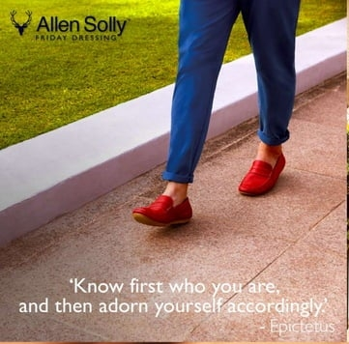
Smart goals of Allen Solly:
Specific: Increase online sales by 30% within the next fiscal year.

Slide 8
Measurable: Track customer satisfaction through post-purchase surveys, aiming for an 85% satisfaction rate.
Achievable: Expand product offerings to include sustainable and eco-friendly fashion lines to meet growing consumer demand for environmentally conscious products.
Relevant: Enhance brand visibility and customer engagement by collaborating with influencers and leveraging social media marketing strategies.
Time-bound: Launch a new marketing campaign by Q1 of the next year to promote the upcoming seasonal collection and achieve a 20% increase in foot traffic to physical stores.

Slide 9
KPIs of Allen Solly:
conversion
average bill value
Average basket size
Average selling price
Salesman
performances
Store sales tracker
Having more potential customers trailing the product each month will drive more customers and ultimately revenue so the KPI will be about growing trail sign ups in each month.
Our customer success team are responsible for delighting our customers ensuring customers don't leave and make sure revenue continues to grow so the KPI will reduce churn rate by a certain amount each month.

Slide 10
1.Sales Revenue:
Measure monthly, quarterly, and yearly sales revenue to track the brand's financial performance.
2.Customer Satisfaction Score (CSAT):
Regularly assess customer satisfaction through surveys or feedback to gauge the brand's effectiveness in meeting customer expectations.
3.Average Order Value (AOV):
Monitor the average amount customers spend per order to understand purchasing behavior and optimize pricing strategies.
4.Sustainability Metrics:
Track and report on sustainability goals, including carbon footprint reduction, eco-friendly product lines, and responsible sourcing initiatives.

Slide 11
Competitor analysis:
1.Vanheusen:
STRENGTHS | WEAKNESSES | OPPORTUNITIES | THREATS
The brand has a wide category of clothing for both men and women in corporate wear. Many international popular celebrities have endorsed Van Heusen. | The brand has to deal with a lot of replica and pirated products which hurts its brand. Strong competition means market share growth is slow. | The brand can increase global penetration into the emerging economies. | Similar designs available in other brands hence switching cost is less. Local market poses a risk.
USP:
The brand is known for its corporate clothing with clean fashionable cuts.

Slide 12
2.Louis Philippe:
STRENGTHS | WEAKNESSES | OPPORTUNTIES | THREATS
Louis Philippe is a brand leader in formal and quasi-formal wear. Good advertising and brand visibility. | Global penetration is limited as compared to a few other international brands . | Global expansion would offer more opportunities. | New brands coming in pose major threat due to competitive pricing. Similar patterns and variety designs available at lesser price from other brands give the customers other options thus making the cost very less.
USP:
It Symbolizes elegance, class, status, and a lifestyle that is distinctly majestic.

Slide 13
3.Peter England :
STRENGTHS | WEAKNESSES | OPPORTUNITIES | THREATS
It was voted among India's Most Trusted Brands. Premium fashion and international fashion also available. One of the largest menswear brand in India with nearly 6 million garments sold every year. | Global penetration is limited as compared to a few other international brands. | It Can diversify into Indian wear as well. Increase global reach would be beneficial for brand growth . | New brands coming in pose major threat because of similar pricing. Similar patterns and verity available at lesser price with other brands or local market.
USP:
Mid-priced value
Readymade men’s wear

Slide 14
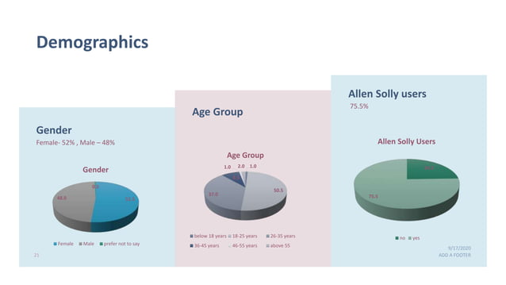
Buyer's/ Audience's persona:
Allen Solly targets Urban Men Upper class and upper middle class.
youngsters of age 22-23 yrs have started entering the workforce. The brand wanted to be more relevant to the new young working class.
The segment that they focus on for marketing is Young fashion for Women and Men.

Slide 15
Segmentation:
Young fashion conscious Women and Men.
Target group:
Urban Men Upper class and upper middle class.

Slide 16
PART-2
Search Engine Optimization(SEO)
&
Keyword Research

Slide 17
SEO & keyword research:
 | Keyword research | Avg.monthly searches | Competiton | Values
1 | How to buy clothes for men | 810 | 69 | 29
2 | Men in women clothing | 780 | 54 | 17
3 | Women in men’s clothes | 620 | 30 | 14
4 | Men wearing women clothes in public | 444 | 12 | 23
5 | How to buy clothes for kids | 583 | 17 | 73
6 | How to buy clothes for women online | 420 | 54 | 22
7 | Kids wearing women’s clothes | 420 | 66 | 47
8 | Men’s wearing kids clothes | 400 | 13 | 342
9 | Women’s clothes for men | 340 | 14 | 228
10 | Naked men women clothing | 510 | 17 | 256
11 | Naked women clothes men | 640 | 17 | 482
12 | Clothes women like on men | 200 | 54 | 25
13 | Clothes men like on women | 180 | 69 | 19
14 | Men caught dressing in women | 220 | 12 | 528
15 | Women caught dressing in men | 190 | 17 | 184
16 | Guide for buying men’s clothes | 270 | 43 | 64
17 | Guide for buying women’s clothes | 160 | 18 | 180
18 | Men clothes made for women | 170 | 18 | 494
19 | Festival clothes for kids | 400 | 81 | 52

Slide 18
SEO audit:
Allen Solly aims to increase its online visibility, attract relevant traffic.
Our commitment is to optimizing various aspects of our website.
Website efficiency:
Website ranks 72/100 and improved more .
SEO can be improved more to attain more than current performances.
Keyword research:
Allen Solly outlet
Allen Solly t- shirts
Allen Solly online etc.
Long tail keyword for Allen Solly:
“Fashion world near you”
“Summer dresses for women by Allen Solly”

Slide 19
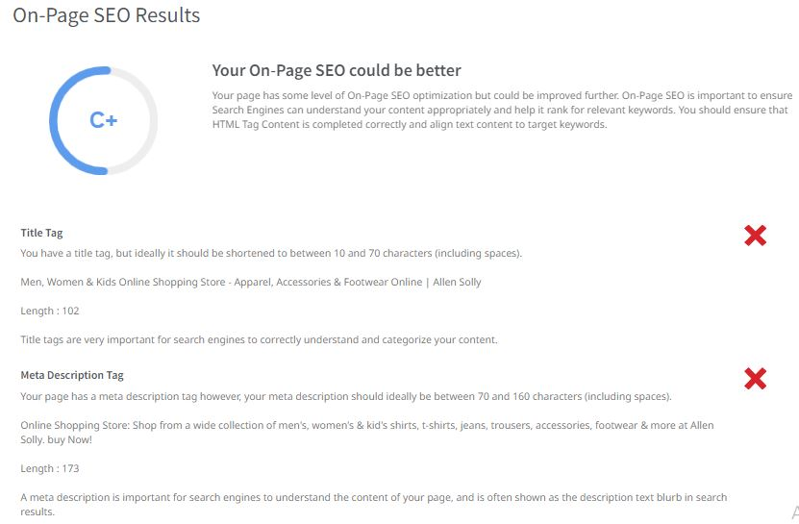

Slide 20
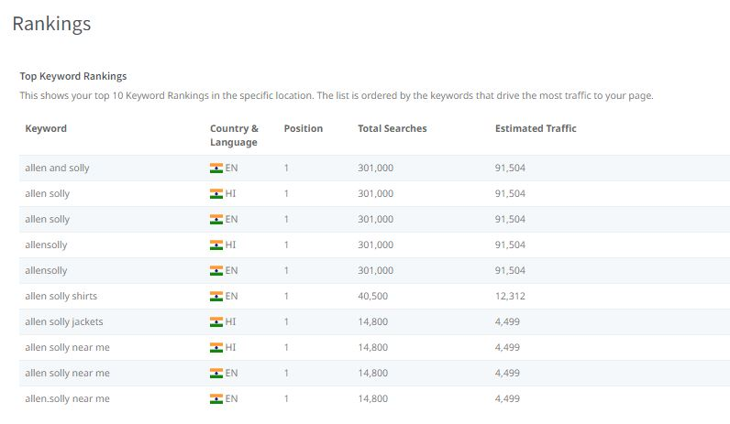
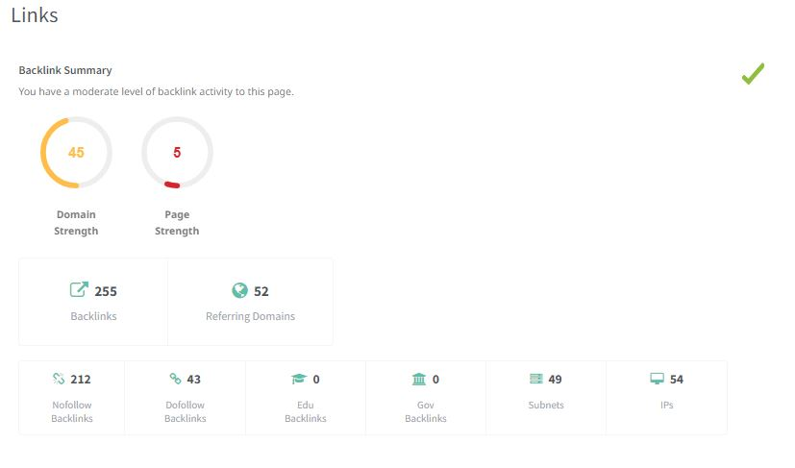

Slide 21
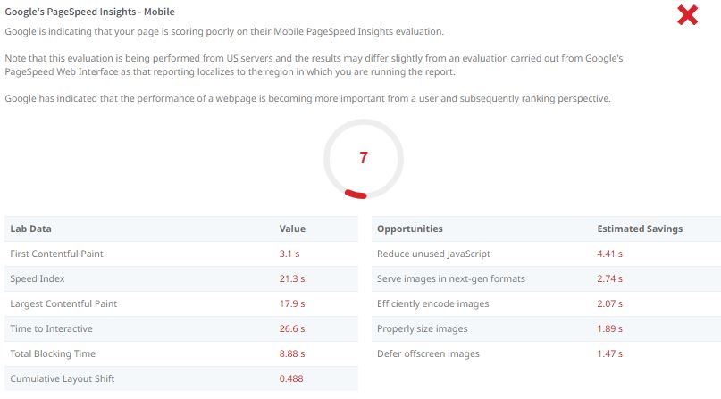
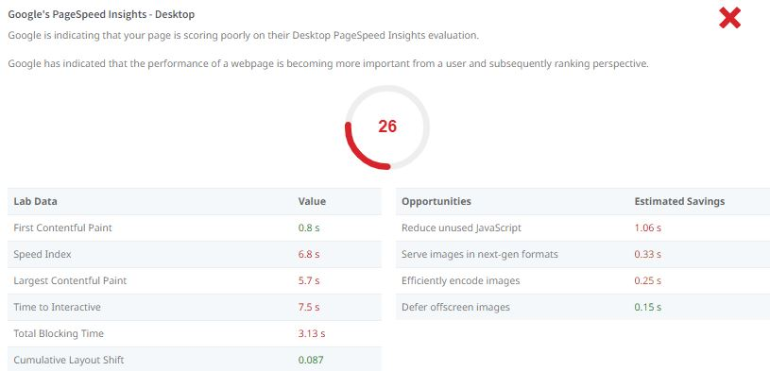

Slide 22
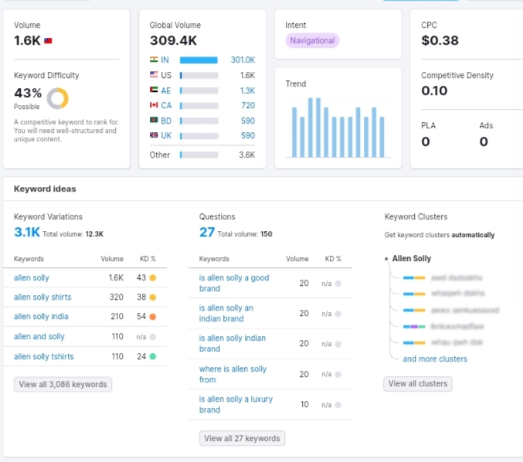
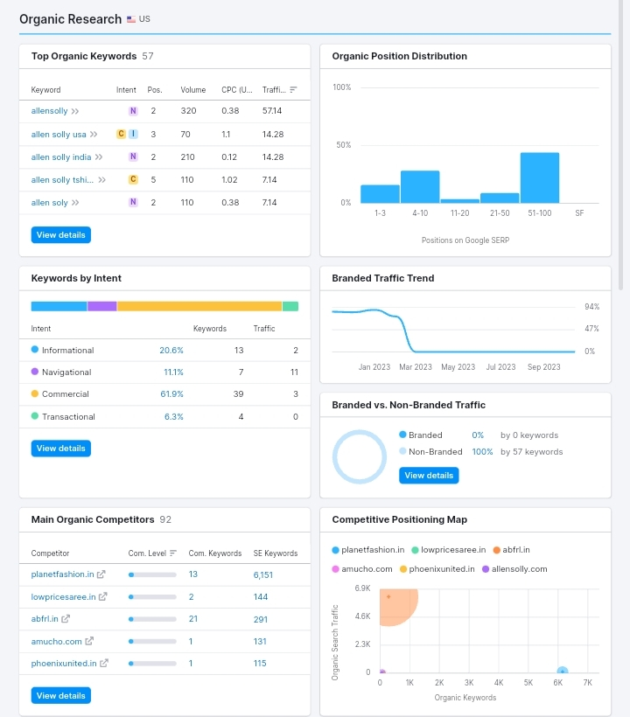
 | Relevant keyword | Avg.monthly searches | competition | Indexed values
1 | Buy clothes for men | 810 | High | 100
2 | Kids clothes online | 583 | High | 100
3 | Buy women clothes online | 710 | High | 100
4 | Meta title Buy kids, men & women clothesonline |  |  | 30
5 | Meta desc Buy latest men, women, kids wear online at heavy discounts and offers |  |  | 56

Slide 23
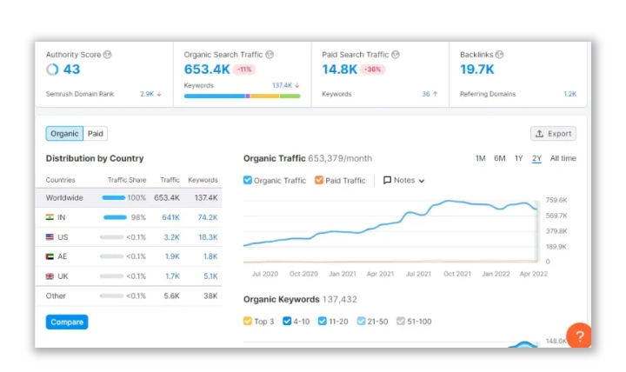
On page optimisation:
The domain score of Allen Solly website is 43 with organic search traffic reaching 653.4k visits and paid search traffic bringing 14.8k new visitors to the website.

Slide 24
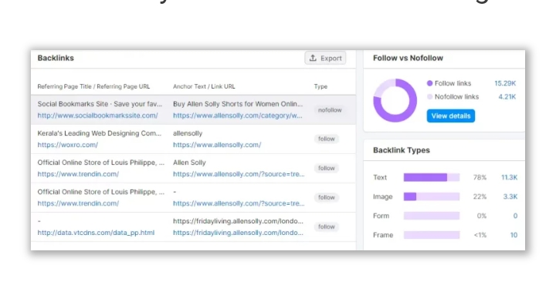
Most of the best backlinks sites where they have submitted links by Allen Solly are shown below

Slide 25
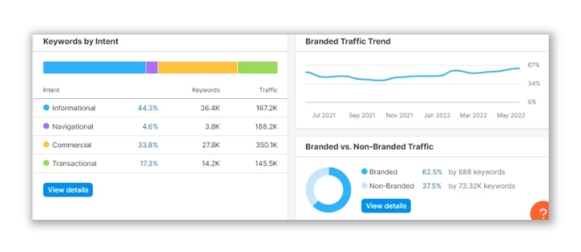
We use 44.3% of informational keywords resulting in 162.7k visitors to the website however 4.6 % navigational keywords bring them far more traffic with 182.6k total visitors in the current month

Slide 26
PART-3
Content ideas
And
Marketing Strategies

Slide 27
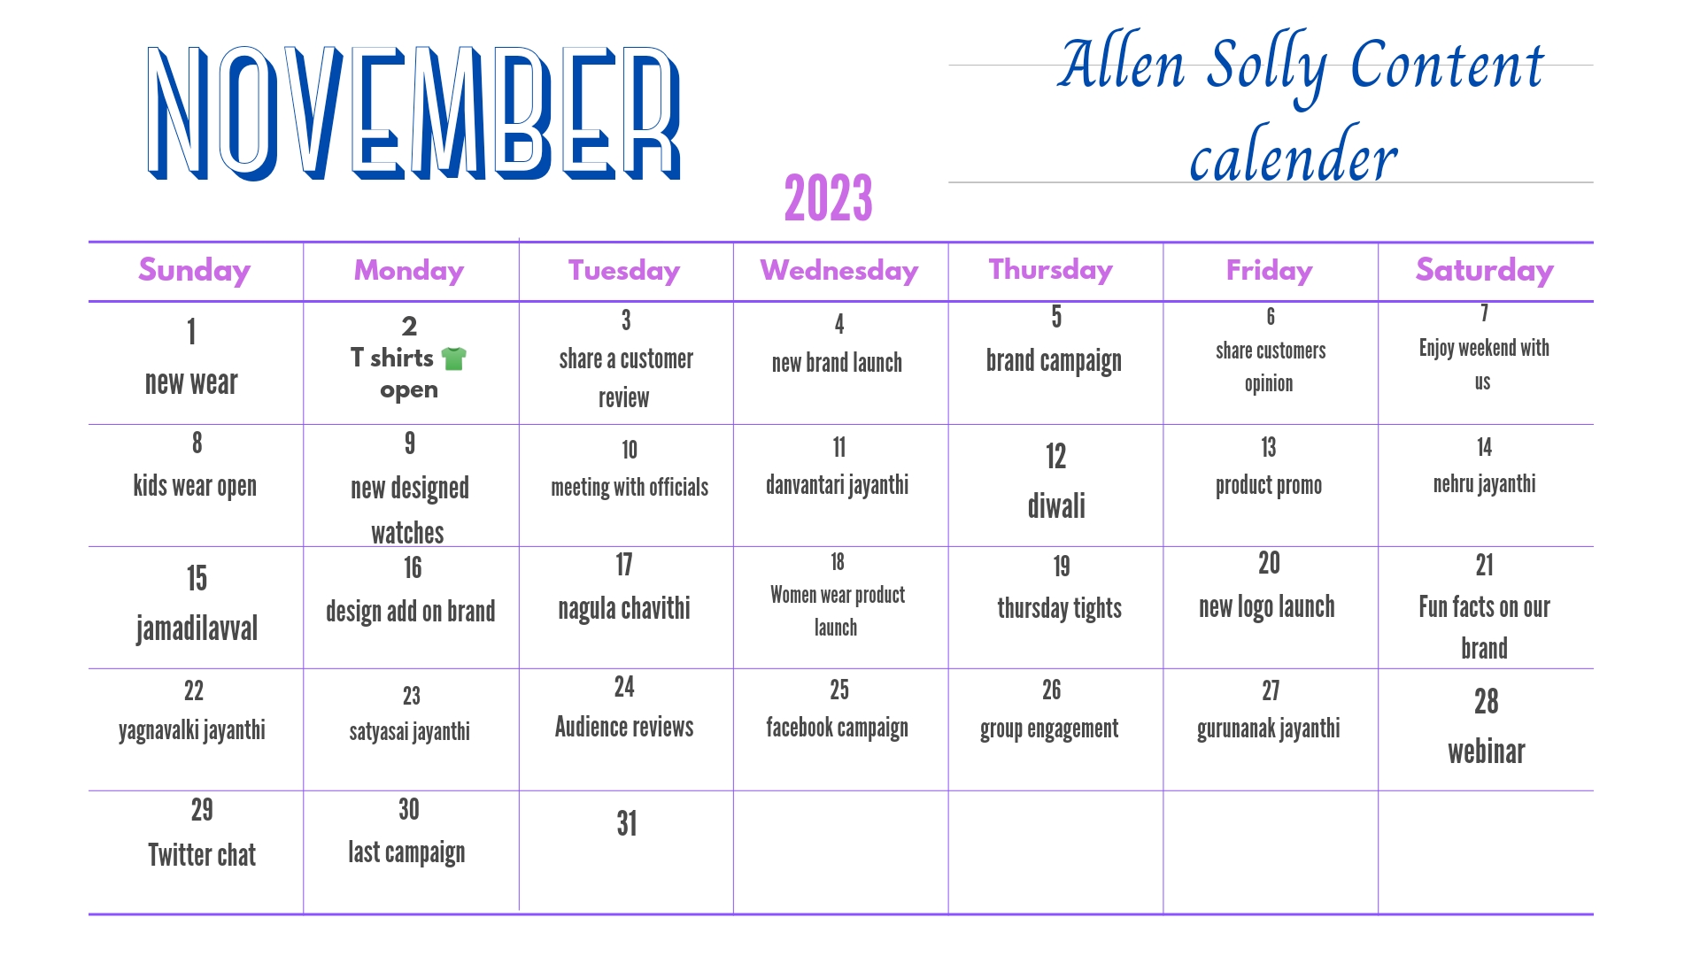
Content ideas and market strategies:
Content calender:

Slide 28
Next marketing strategies:
In the fashion industry, Allen Solly employs various marketing methods, but the marketing mix structure is the one we'll focus on.
The marketing department at Allen Solly comprises four individuals, each of whom is in charge of a distinct aspect of the marketing mix. The pricing approach varies greatly depending on the season.
1.Product Strategy of Allen Solly :
Allen Solly is a textile retailer that manufactures, imports, and exports clothing for men, women, and children.
Allen Solly has stores in 11 cities in India, 100 stores across 40 cities in 24 countries, and 2,300 collection centres and franchise counters.
Allen Solly's product lineup includes casuals, formals and kidswear. The company is known for its exclusive range of formals. Women's Kurtis, sarees, suits, trousers and shirts are popular products.

Slide 29
2. Pricing Strategy of Allen Solly:
Allen Solly focuses on its pricing strategy, especially keeping in mind. the young working population and their purchasing power.
Ideas of "Friday dressing" were introduced to encourage active people to look cool in the office.
3.Promotion & Advertising Strategy:
A renowned footwear brand in India, Allen Solly successfully markets its shoes through specific marketing strategies.
Allen Solly employs a variety of marketing methods to promote its products.
One of the key methods is a corporate partnership, including online promotions, and pre- Friday debuts are all strategies.
4.Facebook strategy:
Facebook's strategy is essential for fashion brands like Allen Solly to stay relevant and profitable.

Slide 30
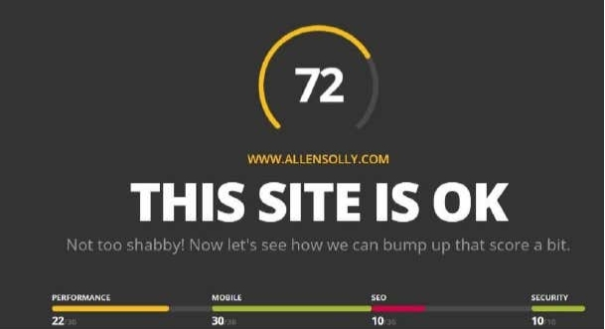
5.Website Strategies:
Fashion is an industry that requires a lot of creativity, but it also requires a lot of networking.
A website strategy is crucial for any fashion brand
Allen Solly publishes marketing, branding, business development, and social media articles.
Allen Solly was an expert in website marketing who wanted to share his knowledge with other business owners.

Slide 31
PART-4
Content Creation and Curation

Slide 32
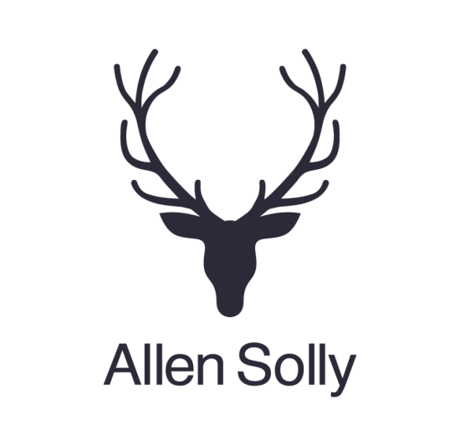

POST CREATION:
Content creation and Curation
Format 1: Article
“Fashion Revolution: The Legacy of Allen Solly”
clothing lines. The brand is recognized for its innovative and contemporary designs, often blending fashion with a touch of professionalism. Established in 1993, Allen Solly has become a prominent name in the fashion industry, appealing to both young professionals and
those seeking stylish yet comfortable attire. Getting dresses that fits them just right…
Allen Solly is an Indian brand that falls under the Aditya Birla Group. It is known for its casual and formal
Caption:
“The Allen Solly Experience: A blend of Fashion, Comfort,
And Confidence. Discover the secret to a stylish life. #AllenSollyMagic

Slide 33
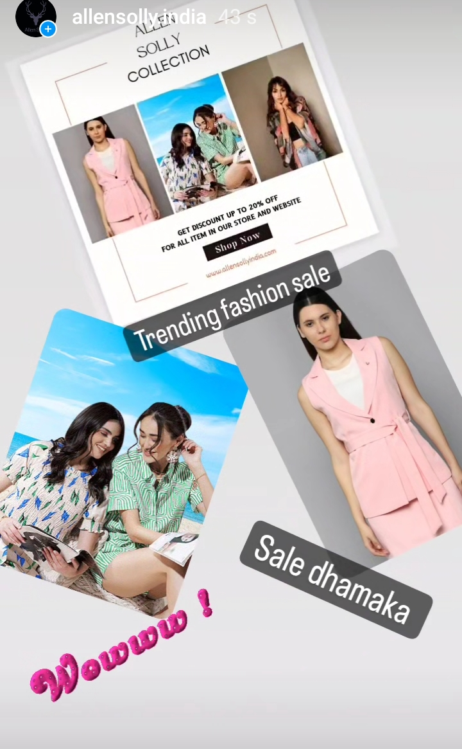
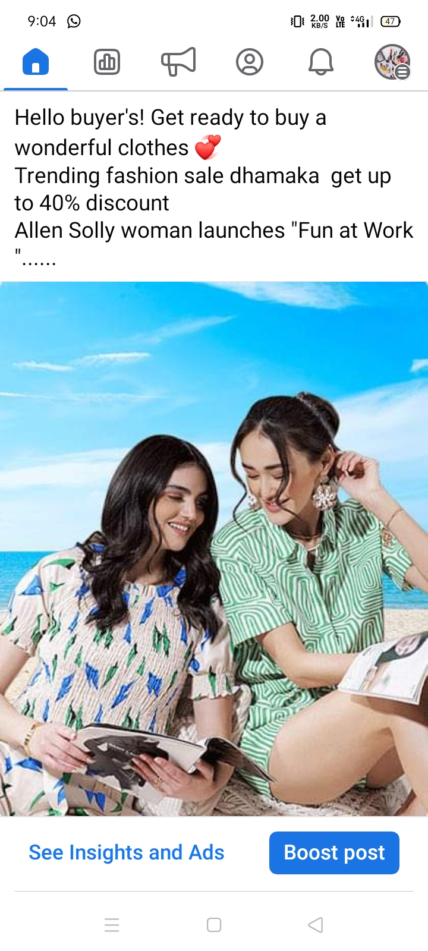
Format 2: Story / Post
#ModernElegance
#VersatileStyle #AllenSolly
#StyleUnveiled

Slide 34
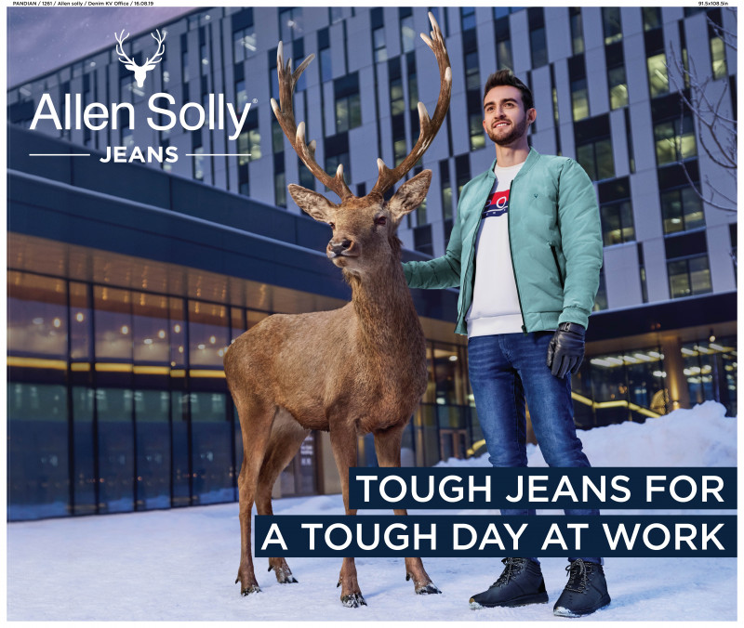
Format 3: Meme
Caption:
“Dressed in Allen Solly, feeling like you can conquer the world.🌍 #FashionEmpowerment #AllenSollyFeels"

Slide 35
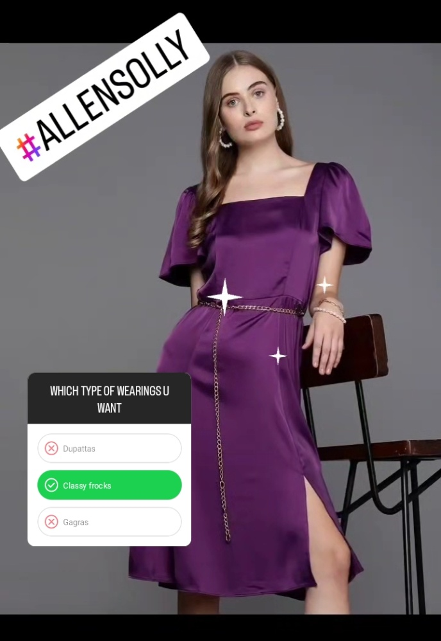
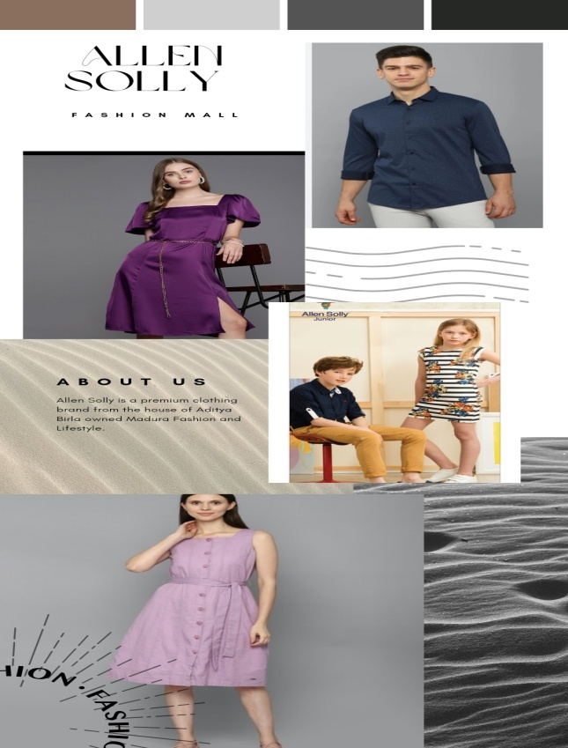
Instagram Story
https://instagram.com/stories/allensolly.india/3211283458198670564?igshid=NjZiM2M3MzIxNA==

Slide 36

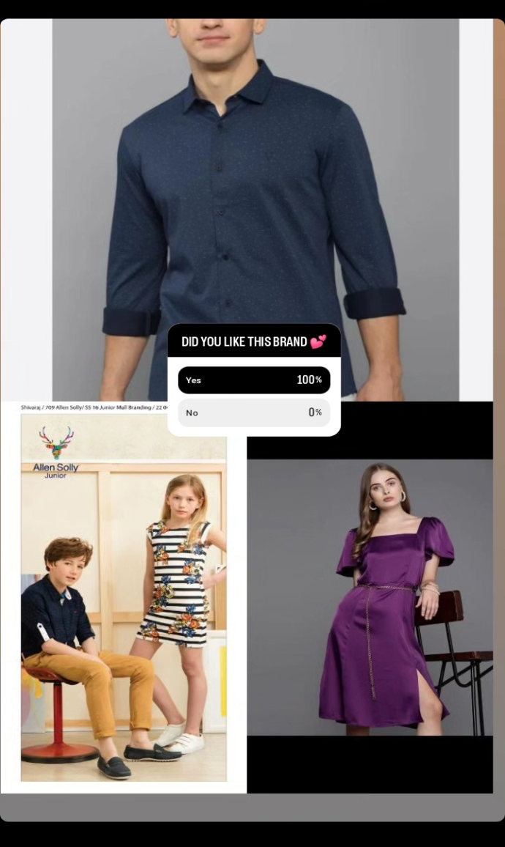
Instagram Story(video) link
https://instagram.com/stories/allensolly.india/321331009210668903 7?igshid=MTc4MmM1YmI2Ng==

Slide 37
TEAM VIDEO:

Slide 38
Thank you
Project done by:
Varsha Gurugubelli
Dummu Raju
Dalli Sravani
Ginni Navya
Dolai Vijaylakshmi

